Slide 1
Time Consumption analysis
Phase 2
Team Members name : Vishnu S
Vishal J
Reshma R
Department Name :
Mentor Name : Dr. G. Sai Krishnan
Artificial Intelligence and Data Science

Slide 2
Phase 1 analysis:
In the previous analysis ,we were able to concluded that car models consumes maximum amount of time , such as BALENO , CELERIO , NEW ERTIGA , NEW SWIFT ,SWIFT, SCROSS , WAGON R , SWIFT DZIRE
Action taken Report :
In the previous meeting, it was mentioned that a more suitable graph or plot should be used for the analysis and report.
To deepen the analysis and find the root cause, we conducted an analysis from both a service perspective and a technician perspective.
We calculated the average time for each technician in their respective service and analyzed the results.

Slide 3
Insights & Analysis
Description :
To find the Root cause for the Time consumption in the Service process with the help of the data analysis
Phase 2 Analysis :
In the phase 2 , analysis where conducted from the technician perspective , the analysis where conducted on 15 technician and 867 customers between 1st Oct to 31st Oct.
In the PMS (Periodic maintenance service) is the most accessed service with count of 489 , RR(Running Repair) with 160 , FR (First Repair)service with 214.
In the analysis , we concluded that certain technician where assigned with more service than others which result in the unequal distribution service among the technician .
This improper distribution management impact the time in the process service which result in the delay delivery in PMS service and RR service types .
The Technician assigned with above average service are SANTHANAM L with 143 , THIRUMURUGAN A with 108, JANARDHANAN V with 87, JERODRAJ V WITH 93 and PALANI R with 58.

Slide 4
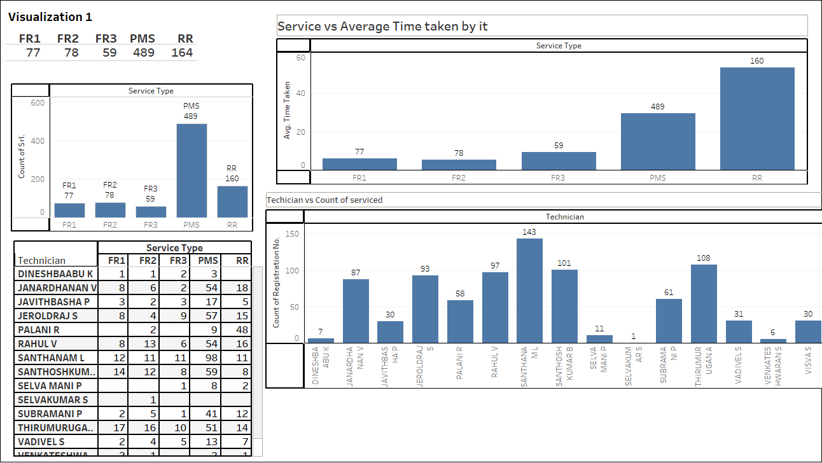
Summary : From the viz , we conclude that there is improper distribution among the technicians and performance of both RR and PMS service .

Slide 5
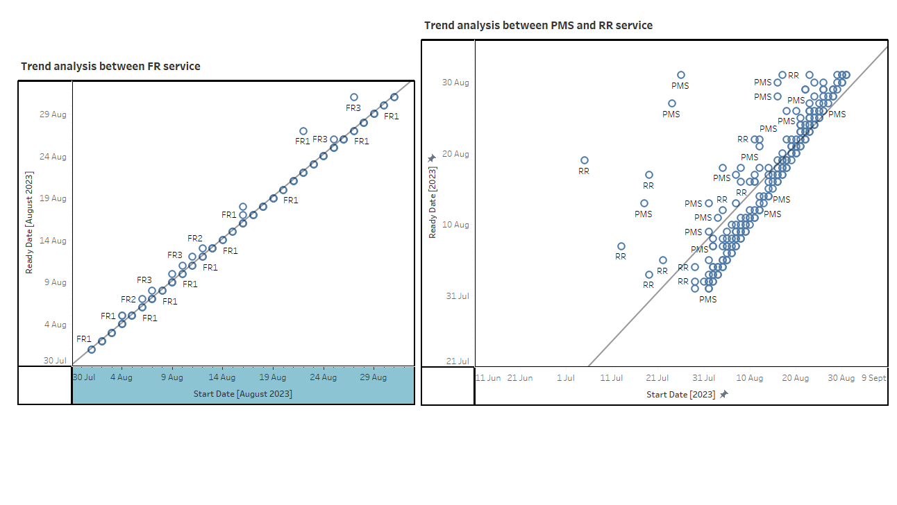
Visualization 2
Summary :This Left Viz helps to understand that FR service are delivered within a day or less than a day with R Squared value = .987( Strong Correlation). The Left viz tells us for some Customer delivered date are delayed than excepted , those points are far from the trend lines with R squared values is .6354 ( Moderate Correlation )

Slide 6
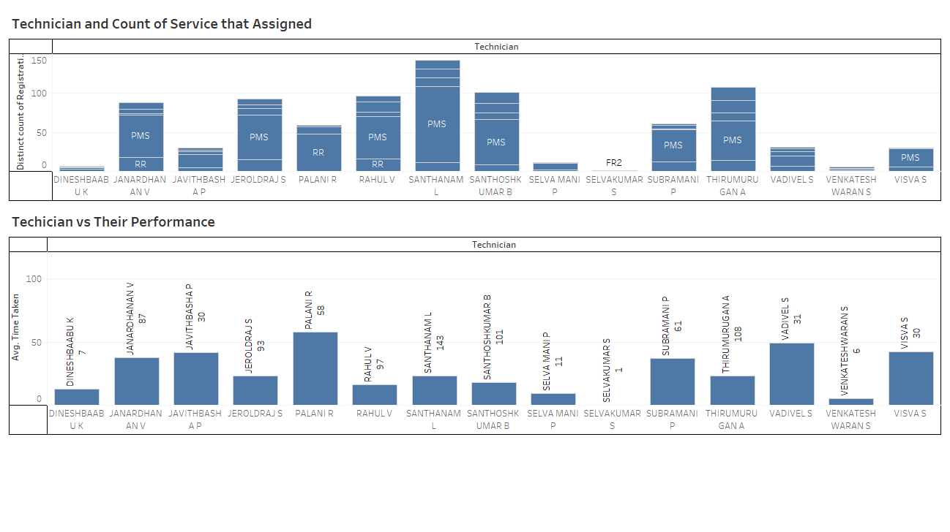
Summary: By comparing both Viz, we can conclude each technician's performance in their field of service. Some of the technicians can perform well despite high distribution but in the case of technicians such as Palani R, Javithbasha P, Janardhan V, Subramani P and Vadivel S.

Slide 7
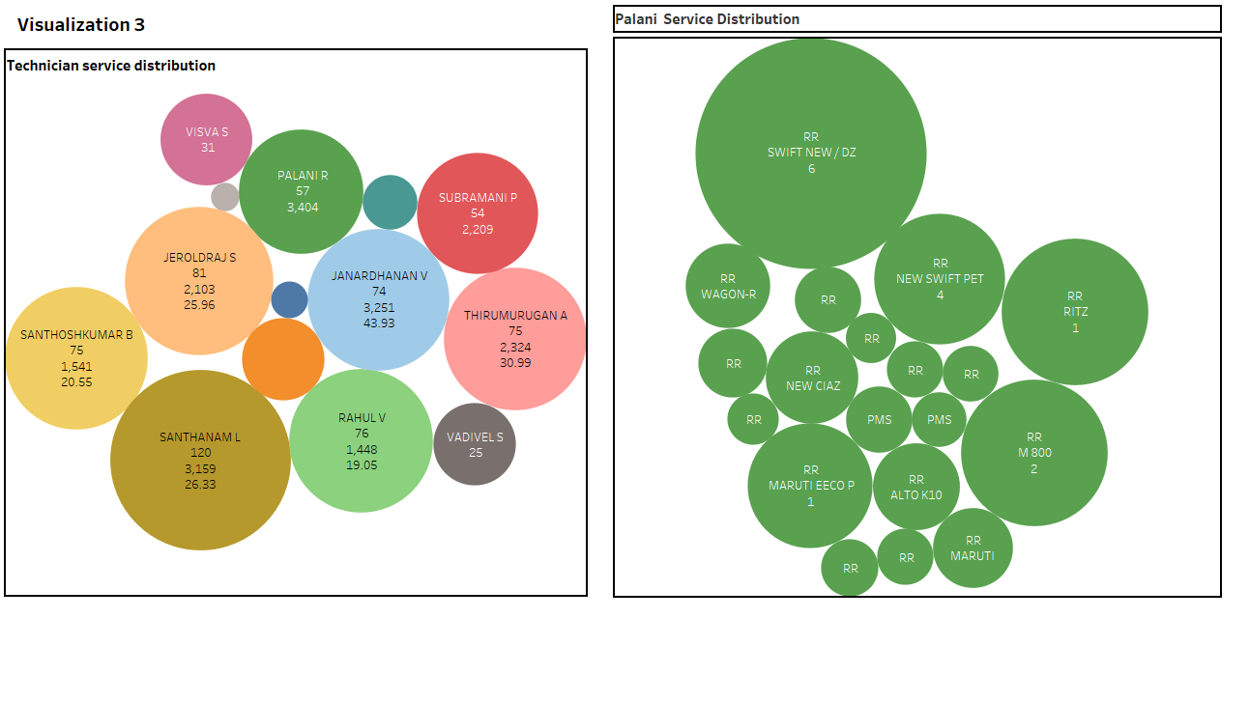
Summary: In comparison with the Previous slide and the Current side , due to improper distribution impact on the performance of the Technician in the service. Analyzing especially the records of Palani R and his service distribution, result in an increase in time consumption and delay in delivery.

Slide 8
Conclusion:
Our analysis from the technician's perspective has shed light on critical aspects of our service operations.
The unequal distribution of service assignments among technicians is evident and impacting in service delivery.
Delays in PMS and RR services are negatively affecting customer satisfaction and operational efficiency.
Recommendations
Optimize Technician Assignments: Implement a fairer distribution of service assignments among technicians to reduce workload disparities.
Training and Skill Enhancement: Offer training and skill development programs to improve the capabilities of technicians with higher service loads.
Resource Allocation: Consider hiring additional technicians or redistributing resources to balance service loads effectively.

Slide 9
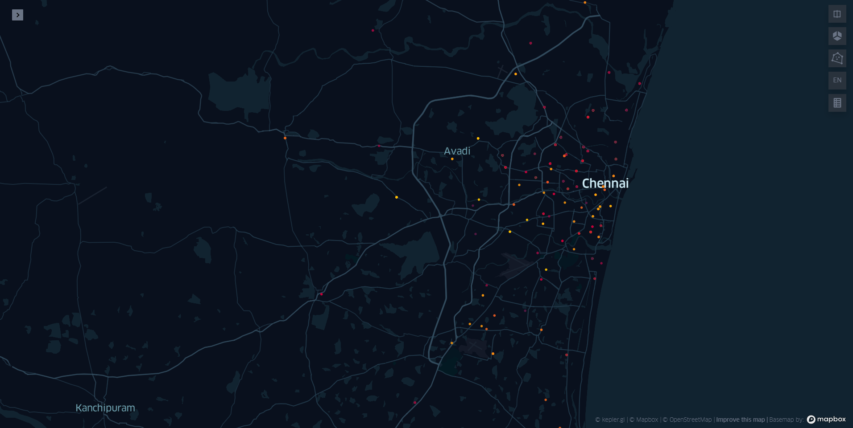
Additional Information:
In the Given dataset , we can also to extract the Location of the customer who visited the Service Center.
With the help of program we developed to obtain the latitude and longitude of customer from the pin code in the dataset
From the Map , We can understand the service center receive customer from dispersed area of the Chennai.

